Slide 1
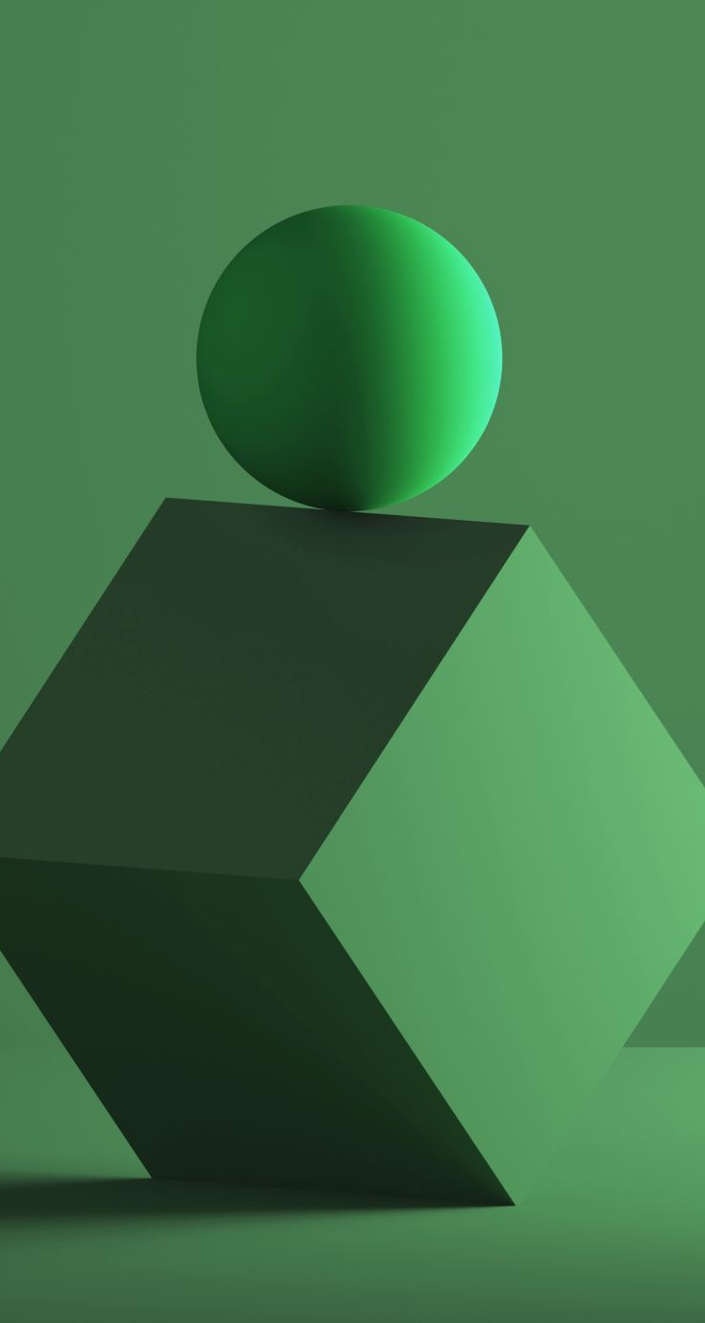
Demo Speech

Slide 2
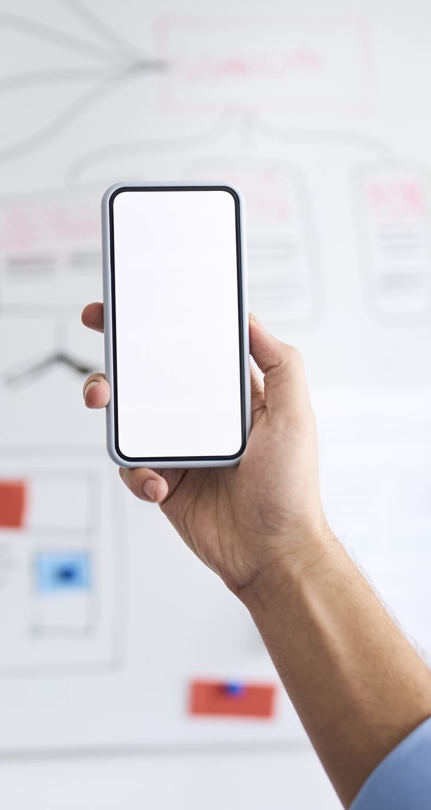
Microsoft has integrated AI capabilities into PowerPoint through features such as Designer and Presenter Coach
Designer automatically generates professional-looking slide designs, while Presenter Coach provides real-time feedback on your presentation skills, pacing, and tone
These AI tools can save you time and effort in creating visually appealing presentations and ensuring that your delivery is engaging
It analyzes your slide content and offers design suggestions, such as recommended images, fonts, and color schemes
It helps you improve your presentation skills by providing real-time feedback on your delivery

Slide 3

As you practice your presentation, Presenter Coach listens to your voice, analyzes your pacing, tone, and other factors, and offers suggestions for improvement
The tool analyzes the content of your slide and generates design suggestions based on the latest design trends
You can choose from a wide range of design options, including images, fonts, and color schemes, to enhance the visual aesthetics of your slides
(Subpoint
2) In addition to using Designer, you can also utilize AI to create custom graphics and charts for visual impact
PowerPoint has built-in tools like Icons, 3D Models, and SmartArt that can be easily customized with AI-powered features

Slide 4

For example, you can use the AI-powered image background removal feature to quickly remove the background of an image and create a custom graphic or use the AI-powered chart suggestions feature to generate visually appealing charts based on your data

